Slide 1
Data analytics Project 4
Detecting Phishing URLs using Machine Learning
By Nairui (David) Guo

Slide 2
A New Growing Threat, Phishing!
Phishing URLs pose a growing threat to Australians, causing financial, personal, and cybersecurity issues.
Incidents of phishing attacks surged by 44% in 2022 compared to the previous year in Australia.
Identity theft cases surged, with a 37% increase in complaints to law enforcement agencies in the last year.
Data breaches due to phishing attacks increased by 52%, exposing sensitive information like health records and financial data.
Cybercriminals accessing email and online services without permission affected 63% of reported cases, leading to mental stress and reputational damage.

Slide 3
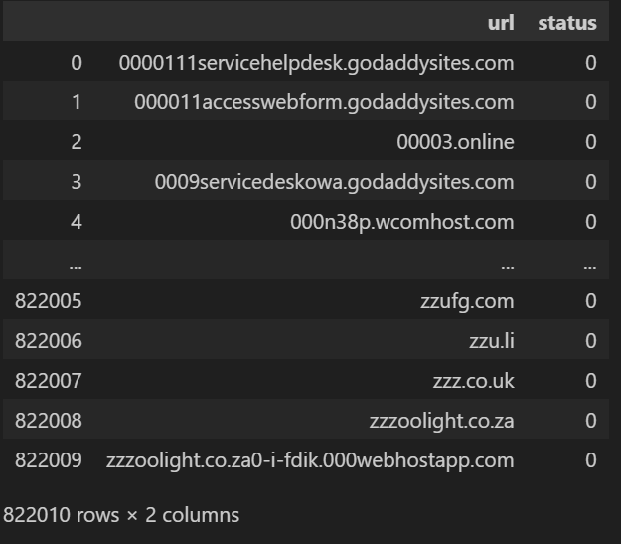

The Data
Data from Kaggle, 'Phishing and Legitimate URLs,' includes 800,000+ web addresses.
52% represent safe websites, while 47% are phishing websites.
Two columns: URL and a "status" label (0 for phishing, 1 for safe), nearly balanced.
Despite balance, perfect accuracy might not be achieved as initially hoped.
Dataset aims to train the computer to differentiate between safe and phishing websites, or at least try to.

Slide 4
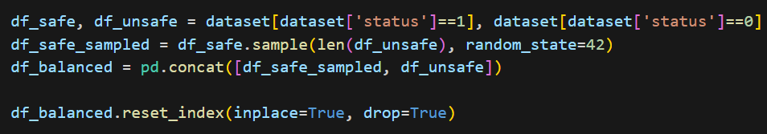
Preparing the Data
Need equal numbers of safe and phishing websites for the task.
Split into Safe (1) and Unsafe (0) categories.
Code randomly matches equal amounts of good and bad sites, creating a balanced dataset.
To ensure balance, the code combines equal numbers of safe and phishing websites using 'pd.Concat' to create a new dataset.

Slide 5
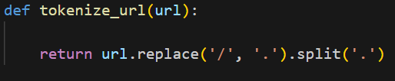
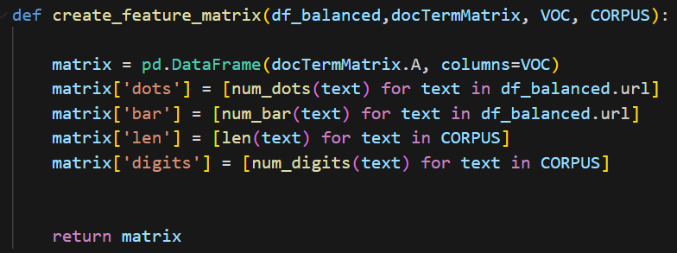
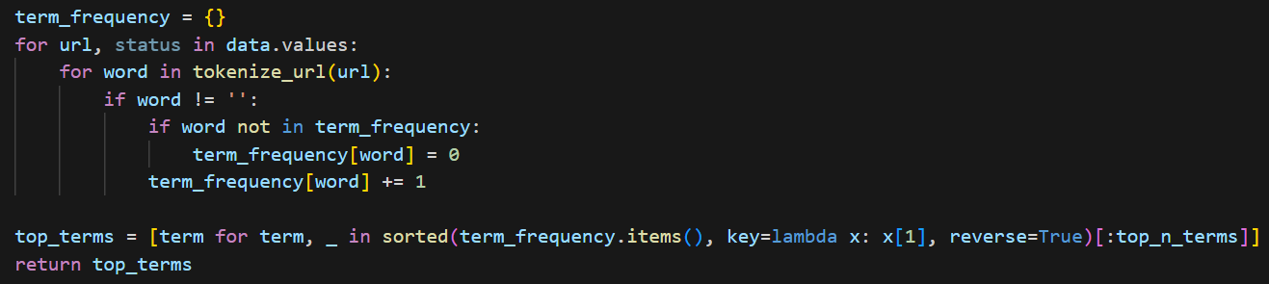
Feature matrix: changing the URLs
To prepare for machine learning analysis of URLs, I sorted out what properties to examine, such as words, numbers, symbols, slashes, and domain names like .com or .org.
Split the data in half, using one part to train the machine learning system and the other to predict if a website is safe or phishing.
Created a feature matrix to count the frequency of terms, involving converting slashes to dots and then counting how often each word appeared in the dataset.
Identified the most common terms by tallying the frequency of each word in the dataset.

Slide 6
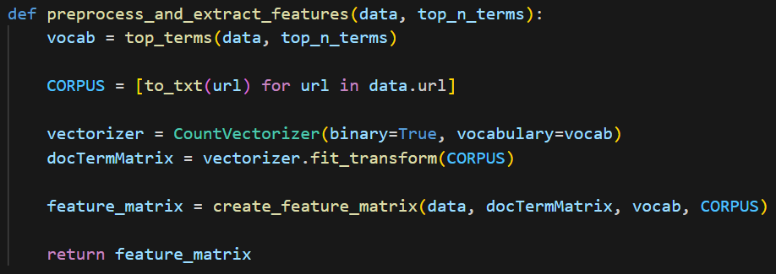
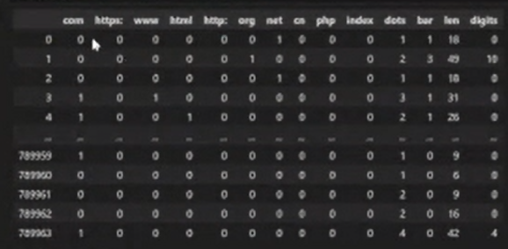
Feature matrix: Converting to CORPUS and using CountVectorizer
Utilized CORPUS to gather words or text from website addresses (URLs), excluding numbers and focusing solely on words.
CountVectorizer, an inbuilt tool, was employed to assign binary numbers to each word from the collected text.
CountVectorizer's function helped generate a feature matrix to count the frequency of each word in the dataset.

Slide 7
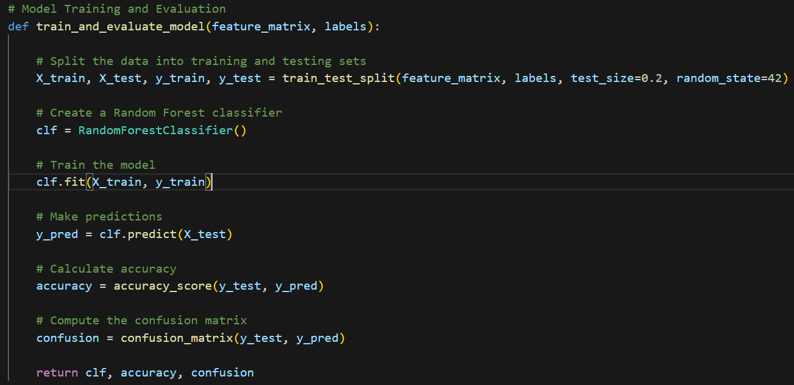
Training and evaluating
Split data for training and testing the model, using half for each purpose.
Features labeled as 'X' and classifications as 'Y' (0 for phishing, 1 for safe).
Employed RandomForestClassifier for machine learning, using '.fit' to train and '.predict' to test the model's accuracy.
Assessed accuracy using the 'accuracy_score' function to predict phishing URLs.
Utilized 'confusion_matrix' to evaluate model performance, categorizing into True Positives, True Negatives, False Positives, and False Negatives.

Slide 8
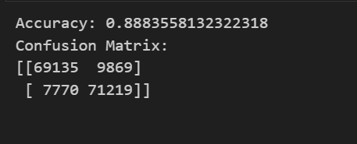
End result
Machine had an 88.84% accuracy
Confusion Matrix shows:
The machine was able to detect 69,135 URLs as Phishing
But failed to detect 9,869 URLs as Phishing
The Machine was able to detect 71,219 URLs as safe
But failed to detect 7,770 URLs as Safe

Slide 9
Conclusion
In conclusion, using machine learning to identify and stop online threats is a big step in making cybersecurity stronger. As phishing attacks keep getting more complicated and trickier to spot, it's important to use technology to stay ahead. By quickly adjusting and using machine learning, we aim to keep up with the always changing world of these tricky websites. This forward-thinking approach not only protects people from the harmful impacts of online threats but also plays a big part in making the online world safer for everyone.

